Slide 1
Factors Affecting Startup’s Success
DS8007 – Advanced Data Visualization Final Project
Ritik Raj

Slide 2
Table Of Contents
Whats Inside?
1
2
3
4
Business Problem Framing and Tools Used
Lets Discuss Datasets
Model Results, Insights and Visualization
Conclusion

Slide 3

1
Business Problem Framing and Tools Used

Slide 4
Business Problem Statement:
PROBLEM
SOLUTION
Startups have emerged as a crucial part of the global economy, and they play a critical role in creating jobs, driving innovation, and generating economic growth.
However, the success rate of startups is low and most of them fail within the first few years
It is essential to understand the factors affecting the success or failure of startups to make informed decisions and improve their chances of success

Slide 5




Business Problem Statement:
What is the success rate of startups globally, and how does it vary across different regions?
Questions to be Answered
01
What are the common reasons for a startup failure and bow does it impact industries and countries?
02
What are the critical factors that contribute to the success of startups, and how do they vary across regions and industries?
03

Slide 6

Tools and Techniques Used:
The Build
Data Visualization
Machine Learning
To explore, analyze and indetify patterns and trends
To predict key factors affecting the success of a Startup
EDA
Python
Data Cleaning, Transformation and Statistical analysis
Pandas, MatplotLit and ScikitLearn For Visualization and ML Models

Slide 7

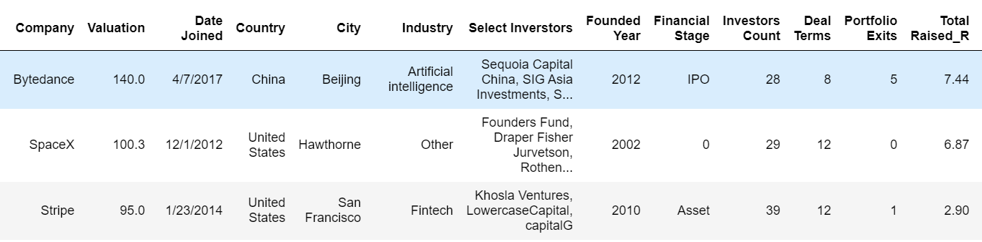
2
Lets Discuss Datasets

Slide 8
Datasets:
2 Unicorn Startups Dataset
01
Dataset 1
Startup Success/Failure Dataset from Crunchbase:
02
Dataset 2:
Worldwide Unicorn Startups Dataset:

Slide 9
Datasets:
Utilization
Dataset 1
25%
Startup Success/Failure Dataset from Crunchbase:
dataset available on Kaggle that contains information on startup companies that have failed or shut down
includes information such as the startup's name, industry, funding details, and reason for failure
Dataset 2
75%
Worldwide Unicorn Startup Dataset
comprehensive collection of data on some of the world's most successful startups
The dataset contains information on 1038 companies that have achieved the coveted "unicorn" status

Slide 10


3
Model Results, Insights and Visualization

Slide 11
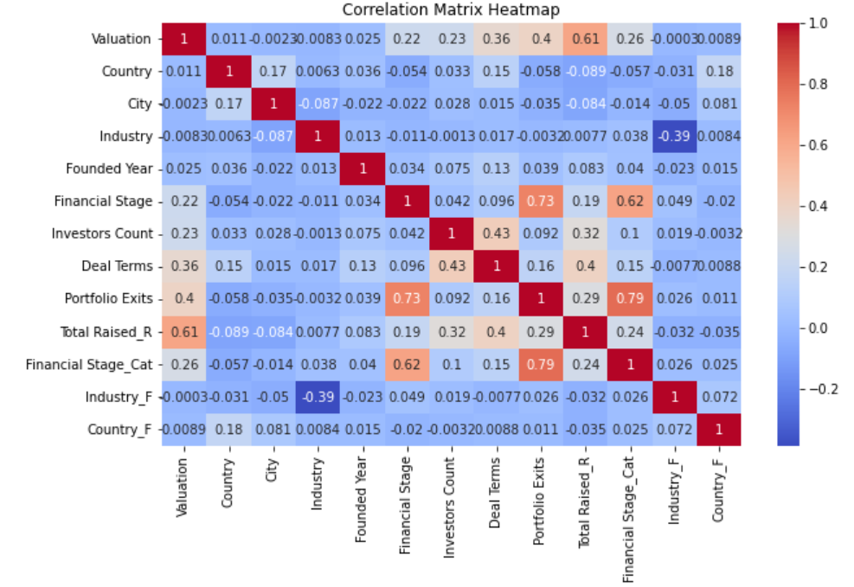
Factors Impacting Startup’s Valuation:
Industry and Amount Raised has the highest correlation with the Valuation
Portfolio exits happen at a certain financial stage – highly correlated

Slide 12
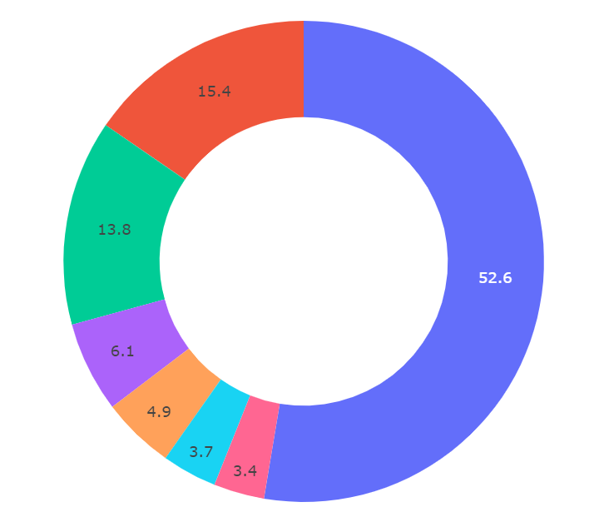
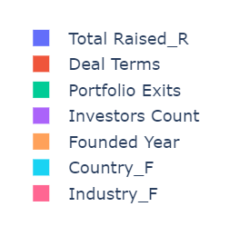
Factors Impacting Startup’s Valuation
52%
Funding Raised
15%
Deal Terms
14%
Portfolio Exits

Slide 13
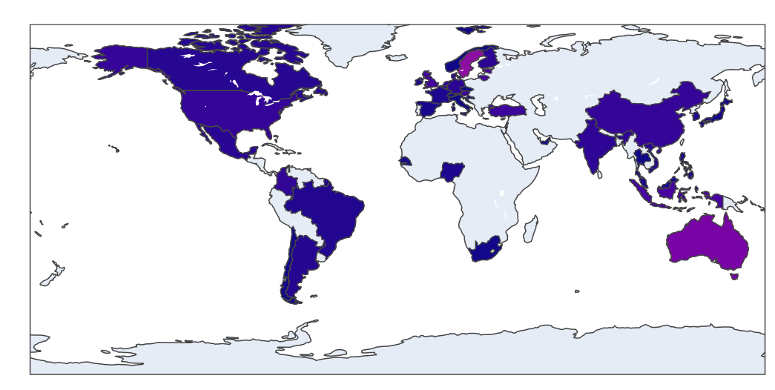
Unicorn Companies By Country/Industry:
Max
Min

Slide 14

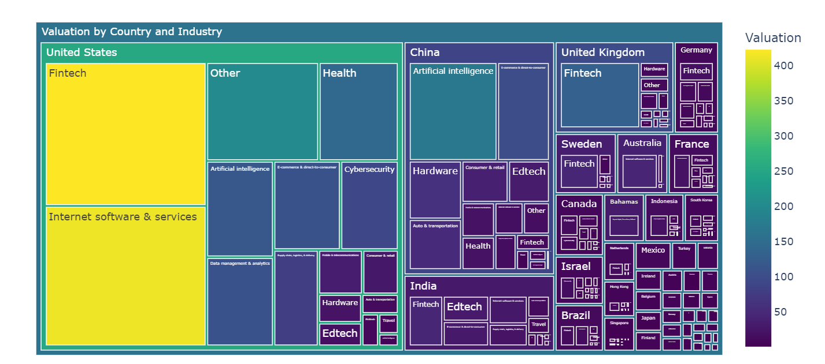
Unicorn Companies By Country/Industry:
Fintech
Internet - Software
E-Commerce
Artificial Intelligence

Slide 15

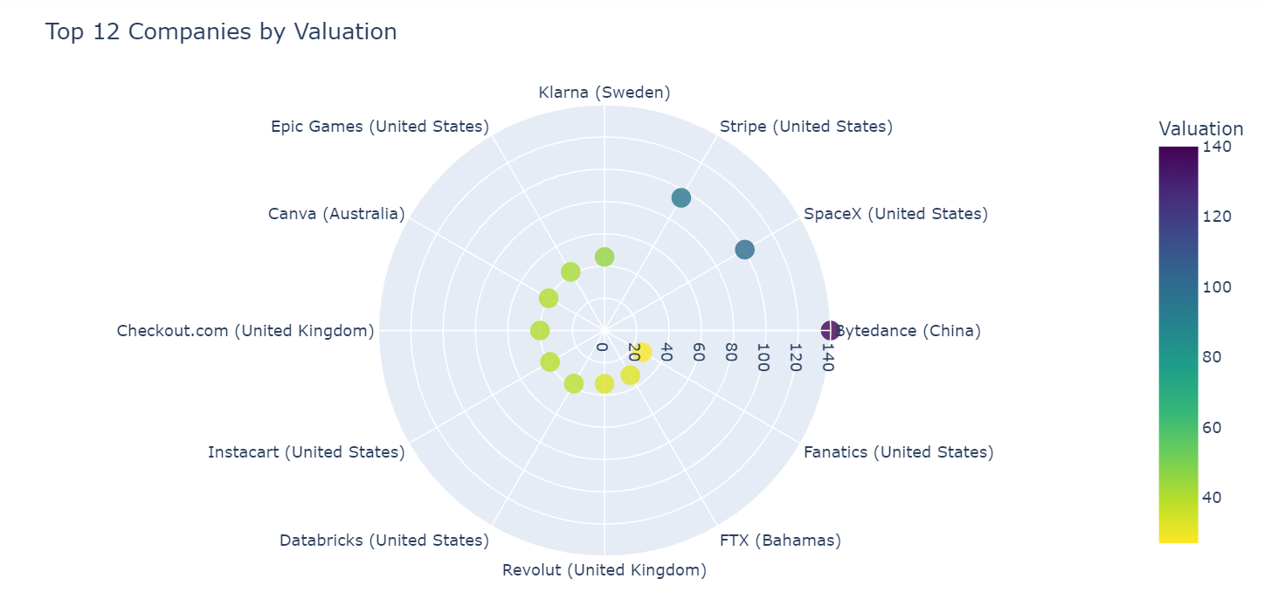
Top 12 Companies – Valuation:
Is it all good to look at Valuations and Companies Achieving it? What are the Industries?
Valuation - Company
140 | Bytedance
100 | SpaceX
95 | Stripe
45.6 | Klarna
42 | Epic Games
40 | Canva

Slide 16
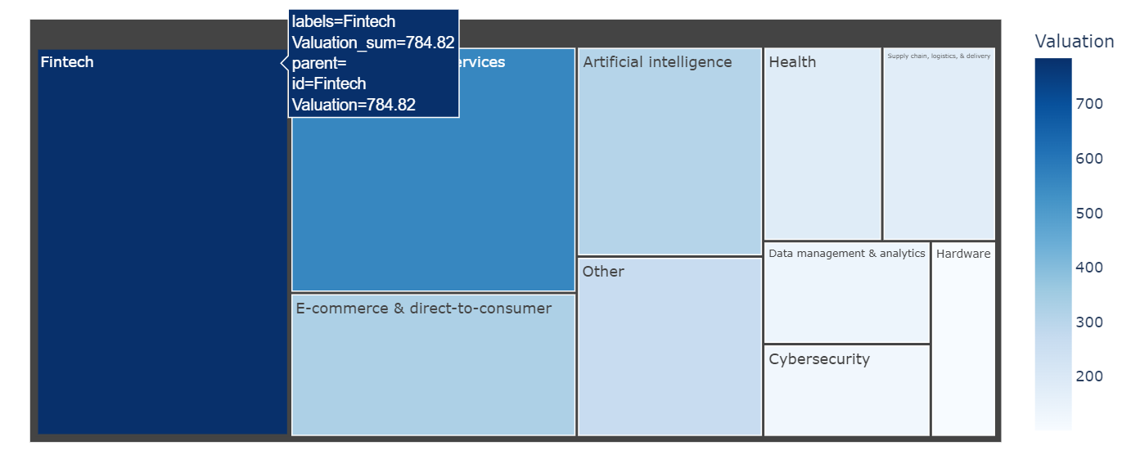
Top Industries – Worldwide:
Fintech | 784.82B
Internet Software and Services | 556.13B
E-Commerce and D2C | 325.39B
Artificial Intelligence | 308.39B
Health | 182.52B

Slide 17
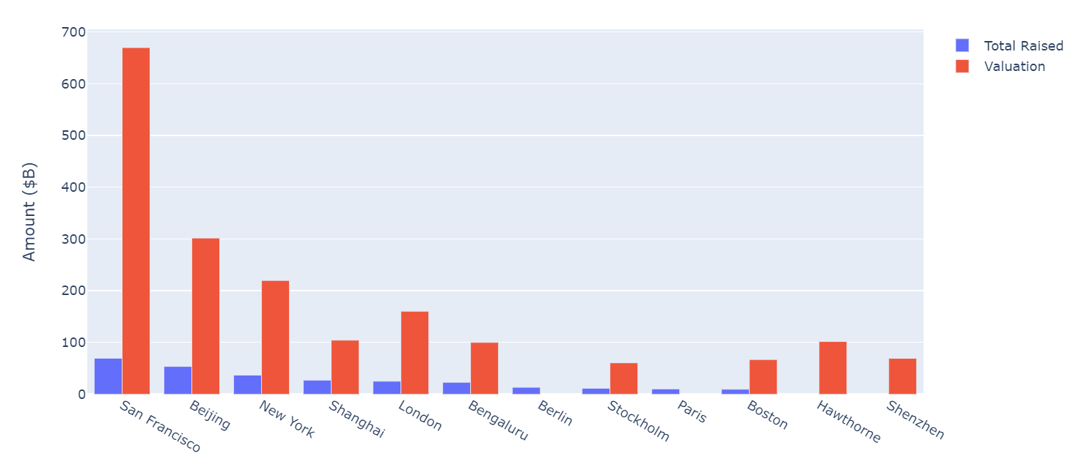
SEZ:
San Francisco
Beijing
New York City
Shanghai
London
Bengaluru

Slide 18
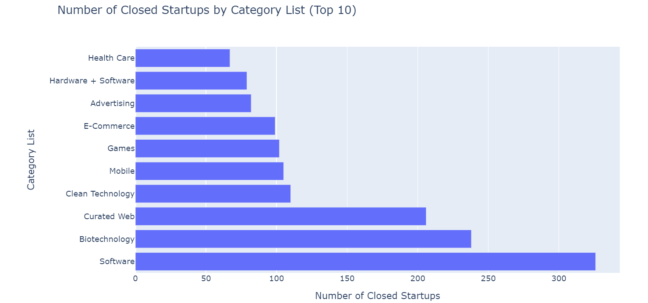
326
238
206
Software
Biotechnology
Curated Web
Failed Mega
Startups

Slide 19


4
Conclusion

Slide 20
Conclusion:
ROAD – SUCCESS ?
Country’s Economy – Huge Impacting Factor
Irrespective of Profits, SEZ help startups with platform to incentivise structure
2
4
1
3
5
Raised Value and Investors panel are an asset to Startup’s Success
Biotech, Curated Web and Clean Tech being 3 most failed industry
Currently, Fintech and Internet Software are the most in-demand startup Industries

Slide 21

Thanks

